Slide 1

Comparative Analysis of Three Edge Detection Algorithms IMGS609 Exploratory Project 01 Presented By: Ramesh Bhatta CIS RIT Imaging Science PhD Program
Rochester Institute Of Technology, One Lomb Memorial Drive
Rochester, New York, 14623

Slide 2
Introduction:
Edge detection: Most basic and fundamental step in Image processing and Analysis and First step in recovering Information From Images.
Image Segmentation
Object Identification
Detect Faces and so on.
This project was chosen to explore and study the most basic features of an image- Edges.
Number of Algorithms are proposed for edge detection, here I used 3 of them and tried to apply and visualize/analyze their outcomes.
Canny Edge Detection Algorithm
Laplacian(LoG) Edge Detection Algorithm
Roberts Edge Detection Algorithm

Slide 3
Technical Description of Methods:
Any simple image can be used as an input/data to the three algorithms and results can obtained from each algorithms as follows:
A. Canny Edge Detection Algorithm:
RGB Image
Grayscale Image
Gaussian Blur
Intensity Gradient Calculation( Sobel Filter)
Thresholding
Hysteresis
NMS
2D
convolution

Slide 4
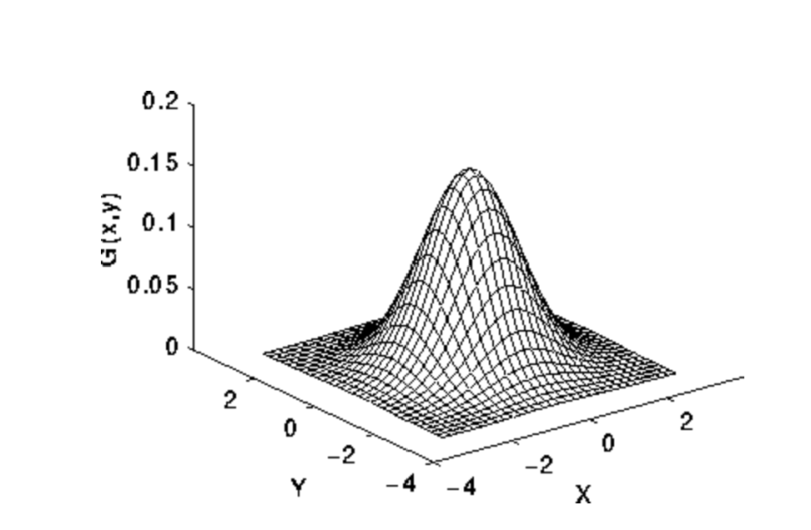
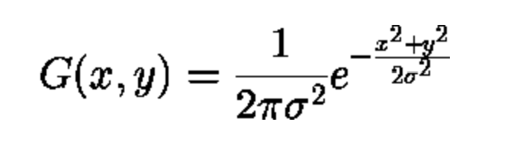
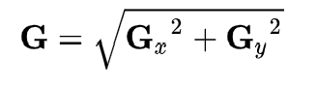
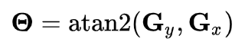
Explanation Of The Steps:
At first the RGB image is converted to Grayscale Image .
The converted Grayscale Image is convolved with a Gaussian kernel to smoothen the image and remove(decrease) noise from it.
After convolution with gaussian kernel, the resulting image is passed through Sobel filter to obtain Gradient approximation in term of gradient magnitude and gradient direction.
and

Slide 5
4. Non-maximum Suppression(NMS):
The method for non-maximum suppression is to identify the pixel with the highest value along an edge.
A pixel can have 4 direction( 0, 45, 90 and 135 degrees) since it have 8 neighboring pixel.
We wish to compare the gradient's magnitude between one pixel and its adjacent pixels in the same direction, and then choose the pixel whose magnitude is the largest.

Slide 6
5. Thresholding:
Next Step is to Keep only those pixel values which are greater than certain high-value and discard those which are less than certain low-value. The pixel with value between high-value and low-value are set as weak value. This process is called Thresholding.
6. Hysteresis:
If any of the neighboring pixels of the weak-value pixel are strong-valued pixel(255) then the weak value are also converted to strong pixel to replace all weak-valued pixel with either 0 value or max(255) value i.e., completed bright or dark pixel.
This completes our Canny Edge Detection Algorithm and produces an edge detected output.

Slide 7
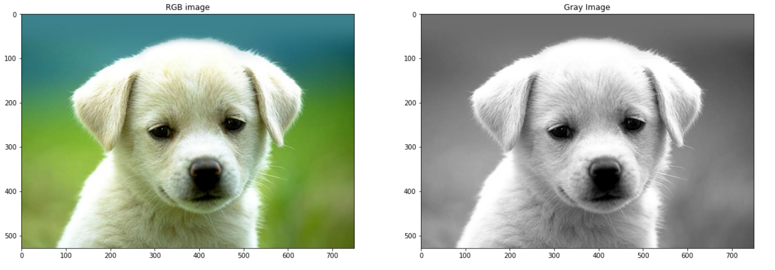
RESULT:
The results from Canny, currently obtained are presented as:
Original Image Source: https://wallpapercave.com/wp/ly2XKAs.jpg

Slide 8
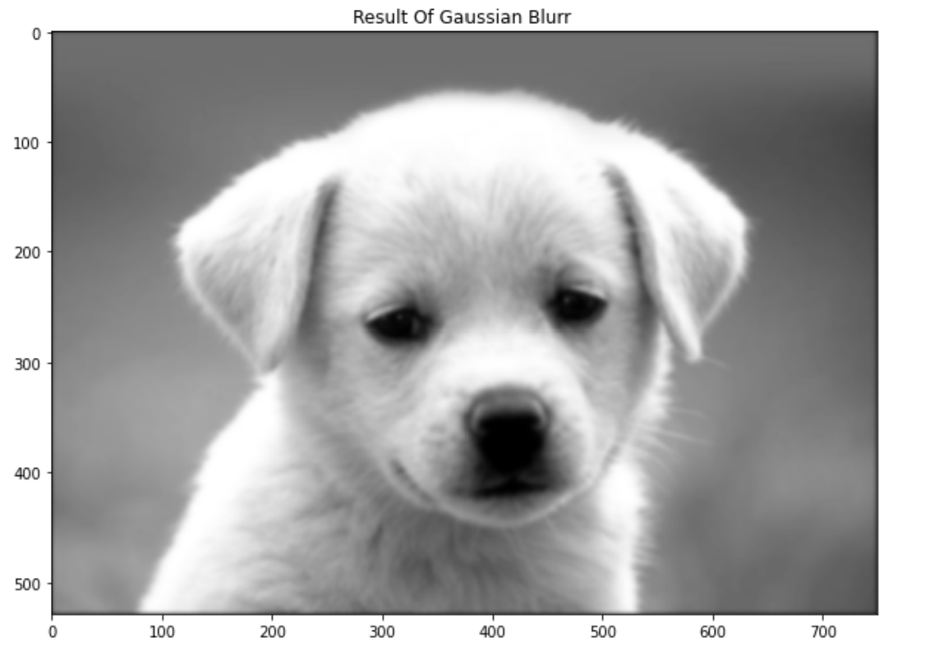
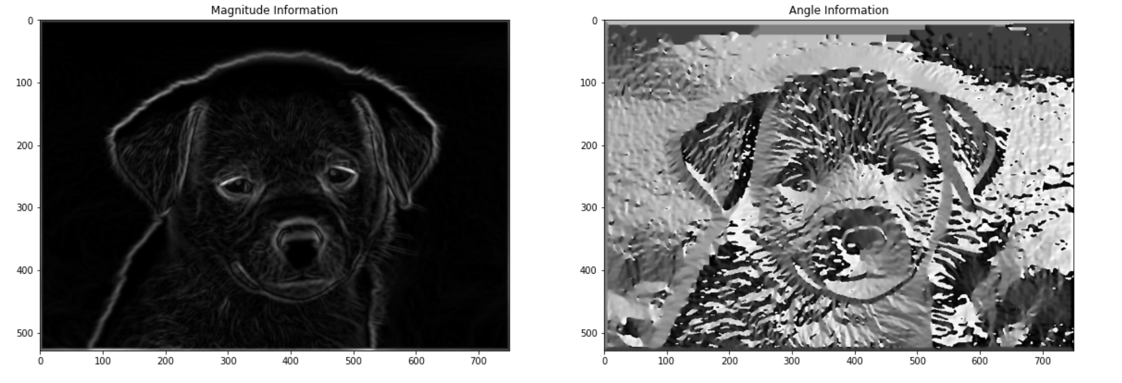

Slide 9
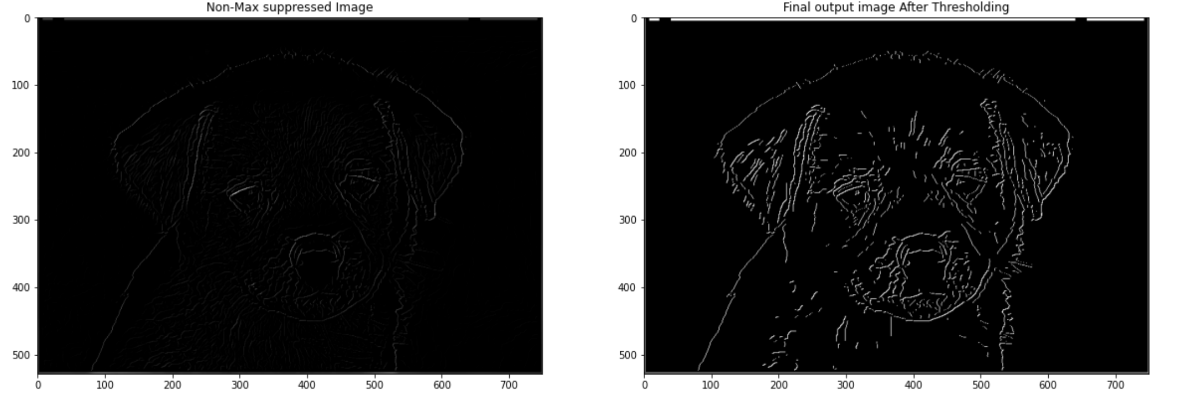

Slide 10
B. Laplacian of Gaussian Edge Detection Algorithm
Grayscale Image
LoG
Zero-Crossing
Output Image

Slide 11
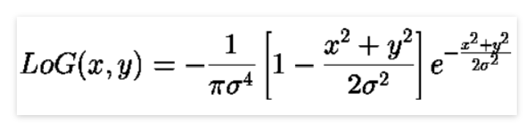
Explanation Of The Steps:
Laplacian of Gaussian Kernel: (Similar to gaussian kernel)
After Determining the LoG kernel, we convolve our Gray image with it.
Then we determine the zero-crossings i.e., if there is change of sign between the current pixel and any of its 8 neighboring pixel then zero-crossing occurs, and the current pixel is the part of edge.

Slide 12
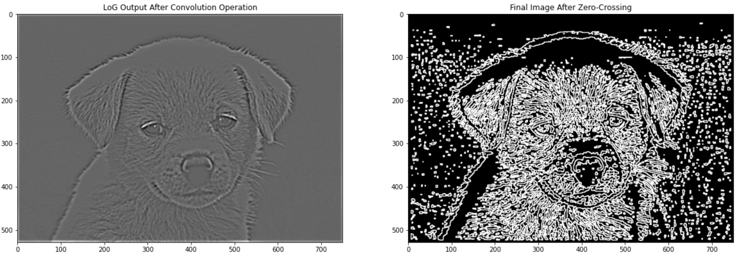
2. LoG Output:

Slide 13
C. Robert Edge Detection Algorithm
Robert Cross
Intensity Gradient Calculation
Thresholding
Output Image

Slide 14
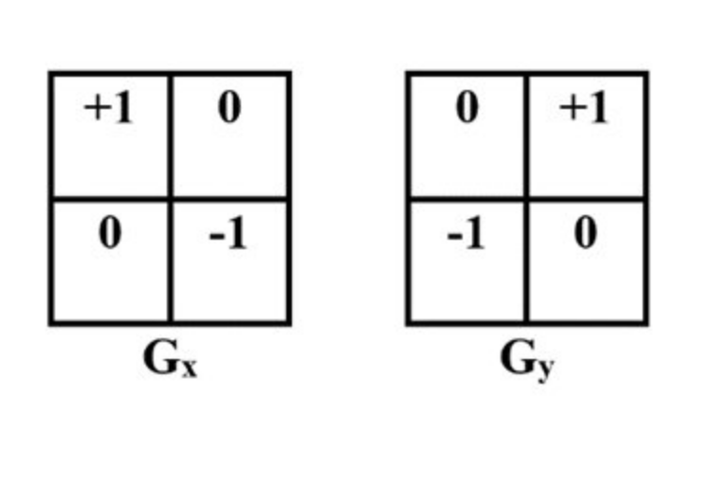
Explanation Of Steps:
Initialize Robert Cross:
Intensity Gradient Calculation
Thresholding

Slide 15
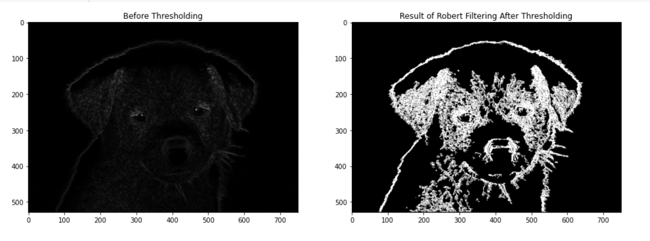
3.Roberts Output:

Slide 16
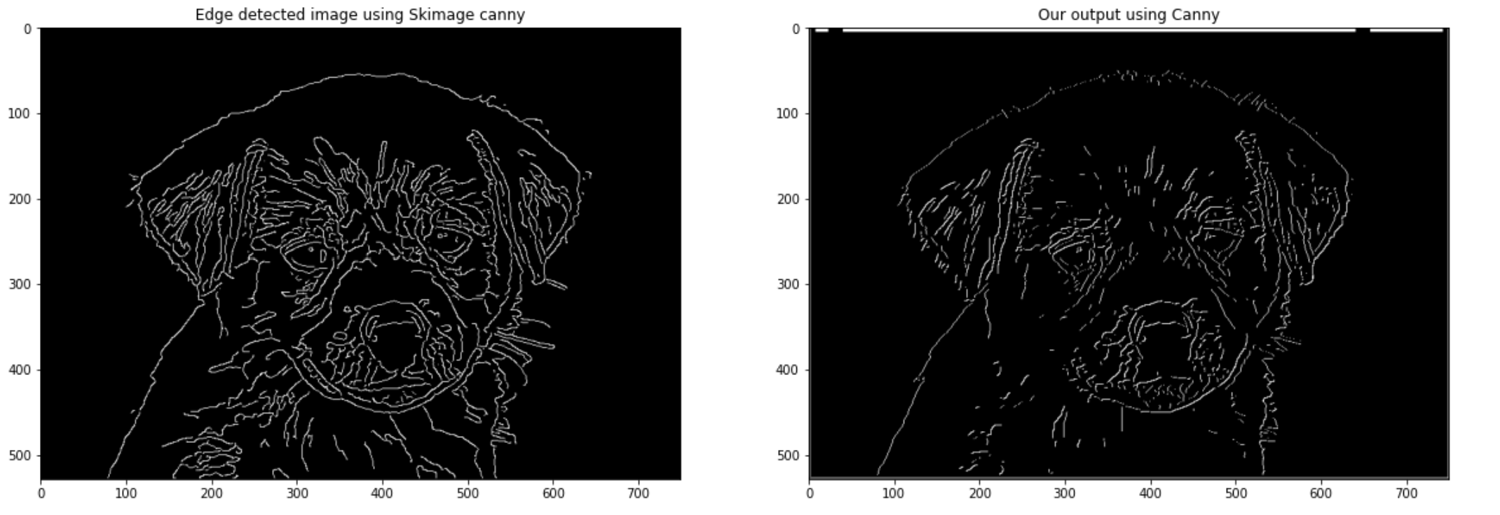
Comparison With Standard Package Outputs:
Canny

Slide 17
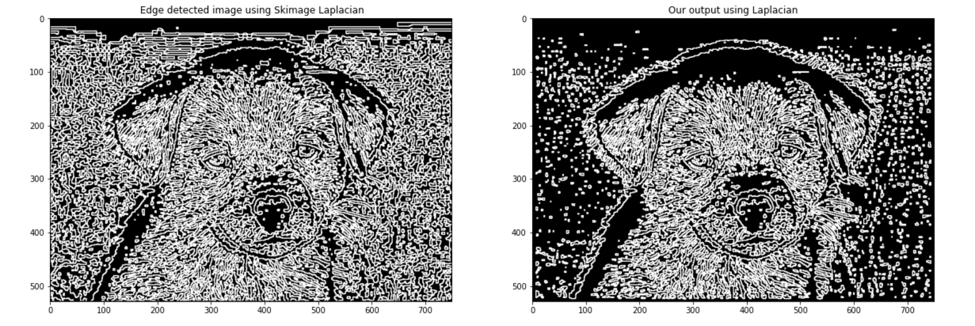
2. LoG:

Slide 18
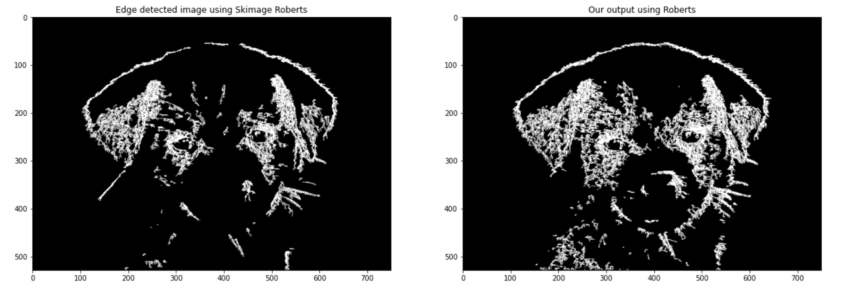
3. Roberts:

Slide 19
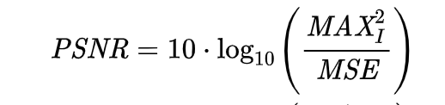
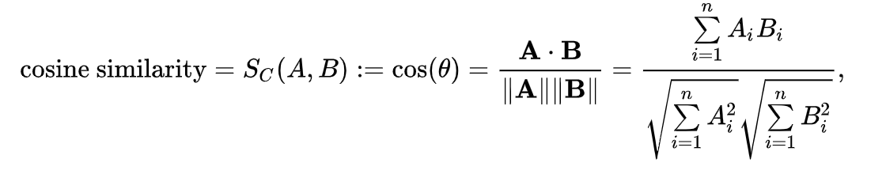
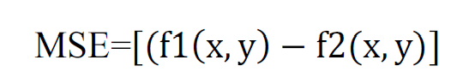
Performance Metrices:
Methods Metrices | PSNR | Cosine-Similarity
Canny | 4.05 | 0.39
LoG | 4.01 | 0.32
Roberts | 4.6 | 0.26

Slide 20
Summary:
Visual comparison shows better results for edge detection for Canny(As it should be).
Similar result from Cosine Similarity. But PSNR shows better value for Roberts as it also takes account the all the other pixel present in image apart from the edge contributing pixels.
Roberts and LoG introduce a lot of noise in the edge detected Image, which needed to be removed or decreased by using some other techniques noise removal techniques.

Slide 21
References:
[1] ReshmaP. (2019). COMPARISON OF VARIOUS EDGE DETECTION ALGORITHMS. http://www.ijser.org
[2] Pande, S., Singh Bhadouria, V., & Ghoshal, D. (2012). A study on edge marking scheme of various standard edge detectors. In International Journal of Computer Applications (Vol. 44, Issue 9).
[3] Kumar, S., Upadhyay, A. K., Dubey, P., & Varshney, S. (2021). Comparative analysis for edge detection techniques. Proceedings - IEEE 2021 International Conference on Computing, Communication, and Intelligent Systems, ICCCIS 2021, 675–681. https://doi.org/10.1109/ICCCIS51004.2021.9397225

Slide 22
THANK YOU!!

